Slide 1
System Software & Architecture
System software differs from application software in machine dependency
  System programs are intended to support the operation and use of the computer itself, rather than any particular application.
Thus, we must include real machines and real pieces of software in our study
Simplified Instructional Computer (SIC)
  SIC is a hypothetical computer (Model or Abstraction or Simulator) that includes the hardware features most often found on real machines, while avoiding unusual or irrelevant complexities
Notes:
The Simplified Instructional Computer (also abbreviated SIC) is a hypothetical (model or abstraction or simulator) computer system introduced in System Software: An Introduction to Systems Programming, by Leland Beck. Due to the fact that most modern microprocessors include subtle, complex functions for the purposes of efficiency, it can be difficult to learn systems programming using a real-world system. The Simplified Instructional Computer solves this by abstracting away these complex behaviors in favor of an architecture that is clear and accessible for those wanting to learn systems programming.

Slide 2
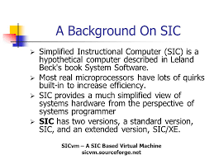

Slide 3
Simplified Instructional Computer
Like many other products, SIC comes in two versions
  The standard model
  An XE version
    “extra equipments”, “extra expensive”
The two versions have been designed to be upward compatible

Slide 4
SIC Machine Architecture (1/5)
Memory
  Memory consists of 8-bit bytes, 15-bit addresses
  Any 3 consecutive bytes form a word (24 bits)
  Total of 32768 (2¹⁵) bytes in the computer memory
Registers
  Five registers, each is 24 bits in length and having both a numeric and character representation:
Mnemonic | Number | Special use
A | 0 | Accumulator
X | 1 | Index register
L | 2 | Linkage register
PC | 8 | Program counter
SW | 9 | Status word

Slide 5
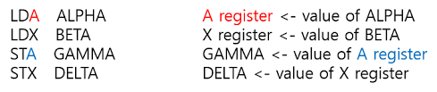

Slide 6
A (0): Used for basic arithmetic operations; known as the accumulator register.
X (1): Stores and calculates addresses; known as the index register.
L (2): Used for jumping to specific memory addresses and storing return addresses; known as the linkage register.
PC (8): Contains the address of the next instruction to execute; known as the program counter register.
SW (9): Contains a variety of information, such as carry or overflow flags; known as the status word register.

Slide 7
SIC Machine Architecture (2/5)
Data formats
  Integers are stored as 24-bit binary number
  2’s complement representation for negative values
  Characters are stored using 8-bit ASCII codes
  No floating-point hardware on the standard version of SIC
Instruction formats
  Standard version of SIC
  The flag bit x is used to indicate indexed-addressing mode.
8 | 1 | 15
opcode | x | address

Slide 8
SIC Machine Architecture (3/5)
Addressing modes
  Two addressing modes
    Indicated by the x bit in the instruction
Mode | Indication | Target address calculation
Direct | x=0 | TA=address
Indexed | x=1 | TA=address+(X)
(X): the contents of register X

Slide 9
SIC Machine Architecture (4/5)
Instruction set: (Appendix A, Page 495)
Load/store registers: LDA, LDX, STA, STX
Integer arithmetic: ADD, SUB, MUL, DIV
  All involve register A and a word in memory, result stored in register A
COMP
  Compare value in register A with a word in memory
  Set a condition code CC (<, =, or >)
Conditional jump instructions
  JLT, JEQ, JGT: test CC and jump

Slide 10
SIC Machine Architecture (5/5)
Subroutine linkage
  JSUB, RSUB: return address in register L
Input and output
  Performed by transferring 1 byte at a time to or from the rightmost 8 bits of register A
  Each device is assigned a unique 8-bit code, as an operand of I/O instructions
  Test Device (TD): < (ready), = (not ready)
  Read Data (RD), Write Data (WD)

Slide 11
Assembler directives
Assembler directive instruct the assembler to perform certain action during the assembly of a program
They are not translated into machine instruction instead they provide instructions to the assembler itself.
Examples
  START: Specify name and starting address of the program
    E.g. COPY START 1000
  END: Indicate the end of the source program and optionally specify the first executable instruction in the program.
    E.g. END FIRST
  BYTE: Generate character or hexadecimal constant occupying as many bytes as needed to represent the constant
    E.g. EOF BYTE C’EOF’
    INPUT BYTE X’F1’

Slide 12
  WORD: Generate one word integer constant
    E.g. THREE WORD 3
  RESB: Reserve number of bytes for data area
    E.g. BUFFER RESB 4096
  RESW : Reserve indicated number of words for a data area
    E.g. RETA RESW 1

Slide 13
SIC Programming Example (Fig 1.2a)
Data movement
LDA FIVE load 5 into A
STA ALPHA store in ALPHA
LDCH CHARZ load ‘Z’ into A
STCH C1 store in C1
.
.
.
ALPHA RESW 1 reserve one word space
FIVE WORD 5 one word holding 5
CHARZ BYTE C’Z’ one-byte constant
C1 RESB 1 one-byte variable

Slide 14
SIC Programming Example (Fig 1.3a)
Arithmetic operations: BETA = ALPHA+INCR-1
LDA ALPHA
ADD INCR
SUB ONE
STA BETA
LDA GAMMA
ADD INCR
SUB ONE
STA DELTA
...
ONE WORD 1 one-word constant
ALPHA RESW 1 one-word variables
BETA RESW 1
GAMMA RESW 1
DELTA RESW 1
INCR RESW 1

Slide 15
SIC Programming Example (Fig 1.4a)
Looping and indexing: copy one string to another
LDX ZERO initialize index register to 0
MOVECH LDCH STR1,X load char from STR1 to reg A
STCH STR2,X
TIX ELEVEN add 1 to index, compare to 11
JLT MOVECH loop if “less than”
.
.
.
STR1 BYTE C’TEST STRING’
STR2 RESB 11
ZERO WORD 0
ELEVEN WORD 11

Slide 16
SIC Programming Example (Fig 1.5a)
LDA ZERO initialize index value to 0
STA INDEX
ADDLP LDX INDEX load index value to reg X
LDA ALPHA,X load word from ALPHA into reg A
ADD BETA,X
STA GAMMA,X store the result in a word in GAMMA
LDA INDEX
ADD THREE add 3 to index value
STA INDEX
COMP K300 compare new index value to 300
JLT ADDLP loop if less than 300
...
...
INDEX RESW 1
ALPHA RESW 100 array variables—100 words each
BETA RESW 100
GAMMA RESW 100
ZERO WORD 0 one-word constants
THREE WORD 3
K300 WORD 300

Slide 17
SIC Programming Example (Fig 1.6)
Input and output
INLOOP TD INDEV test input device
JEQ INLOOP loop until device is ready
RD INDEV read one byte into register A
STCH DATA
.
.
OUTLP TD OUTDEV test output device
JEQ OUTLP loop until device is ready
LDCH DATA
WD OUTDEV write one byte to output device
.
.
INDEV BYTE X’F1’ input device number
OUTDEV BYTE X’05’ output device number
DATA RESB 1

Slide 18
SIC/XE Machine Architecture (1/11)
Memory
  Maximum memory available on a SIC/XE system is 1 megabyte (2²⁰ bytes)
  An address (20 bits) cannot be fitted into a 15-bit field as in SIC Standard
  Must change instruction formats and addressing modes

Slide 19
SIC/XE Machine Architecture (2/11)
Registers
  Additional registers are provided by SIC/XE
Mnemonic | Number | Special use
B | 3 | Base register
S | 4 | General working register
T | 5 | General working register
F | 6 | Floating-point accumulator (48 bits)

Slide 20
SIC/XE Machine Architecture (3/11)
There is a 48-bit floating-point data type
  fraction is a value between 0 and 1
  exponent is an unsigned binary number between 0 and 2047
  zero is represented as all 0
1 | 11 | 36
s | exponent | fraction
f*2^{(e-1024)}

Slide 21
SIC/XE Machine Architecture (4/11)
Instruction formats
8
op
Format 1 (1 byte)
8 | 4 | 4
op | r1 | r2
Format 2 (2 bytes)
6 | 1 | 1 | 1 | 1 | 1 | 1 | 12
op | n | i | x | b | p | e | disp
Format 3 (3 bytes)
6 | 1 | 1 | 1 | 1 | 1 | 1 | 20
op | n | i | x | b | p | e | address
Format 4 (4 bytes)
Formats 1 and 2 do not reference memory at all
Bit e distinguishes between format 3 and 4

Slide 22
Examples
Format 1 (1 Byte)
  RSUB (Return to subroutine)
  4 C
Format 2 (2 byte)
  COMPR A,S
  Opcode A S
  A 0 0 4
  Note : Format 1 and 2 are used for those instruction that do not refer memory at all
0100 1100
1010 0000 0000 0100

Slide 23
Format 3 (3 byte)
  LDA #3
  n i x b p e
  0 1 0 0 0 3
If n=1 indirect addressing
i=1 immediate addressing
x=1 Indexed addressing
b=1 Base relative addressing
p=1 Program counter relative addressing
000000 | 0 | 1 | 0 | 0 | 0 | 0 | 0000 0000 0011

Slide 24
Format 4 (4 bytes)
  +JSUB RDREC (Jump to address 1036)
  4 B 1 0 1 0 3
  Note: Bit ‘e’ is used to distinguish between format 3 and 4.
  e=0 means format 3 and e=1 means format 4
010010 | 1 | 1 | 0 | 0 | 0 | 1 | 0000 0001 0000 0011 0110

Slide 25
Addressing modes
Addressing modes refers to the way in which the operand
of an instruction is specified.
Addressing modes
  Relative addressing modes
    Base relative addressing mode
    Program counter relative addressing mode
  Direct addressing mode
Other addressing modes
  Indexed addressing mode
  Immediate addressing mode
  Indirect addressing mode
  Simple addressing mode

Slide 26
  Note:
  PC-relative or Base-relative addressing: op m
  Indirect addressing: op @m
  Immediate addressing: op #c
  Extended format: +op m
  Index addressing: op m,x

Slide 27
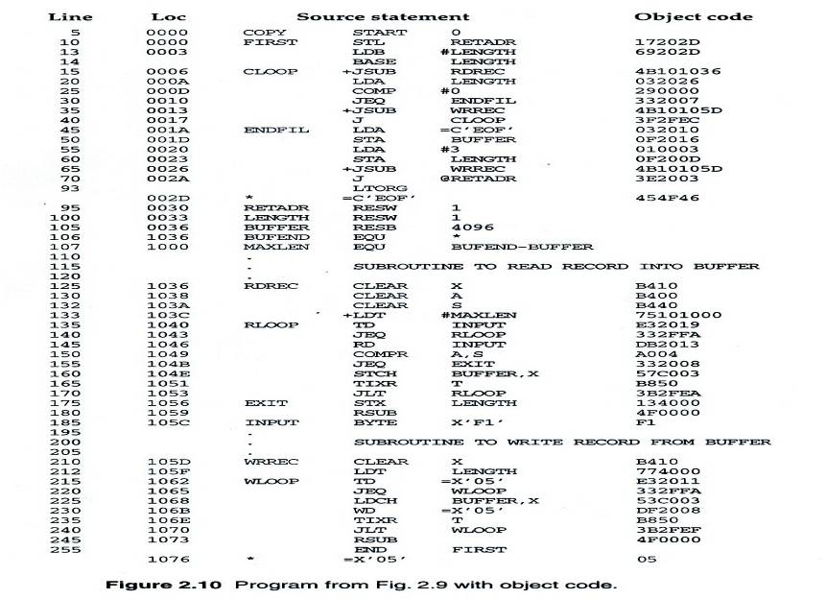

Slide 28
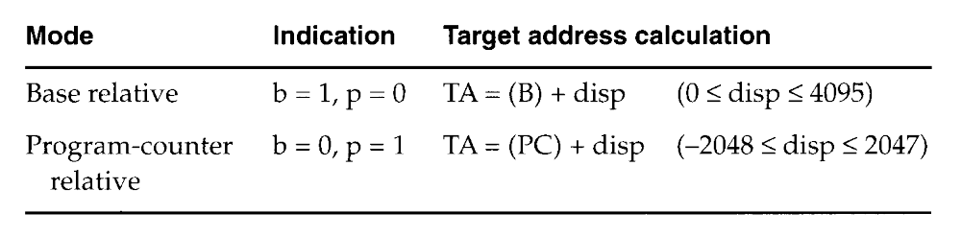
Relative addressing mode

Slide 29
SIC/XE Machine Architecture (5/11)
Base Relative Addressing Mode
Program-Counter Relative Addressing Mode
 | n | i | x | b | p | e
opcode |  |  |  | 1 | 0 |  | disp
b=1, p=0, TA=(B)+disp (0≤disp ≤4095)
 | n | i | x | b | p | e
opcode |  |  |  | 0 | 1 |  | disp
b=0, p=1, TA=(PC)+disp (-2048≤disp ≤2047)

Slide 30
Example:
  0000 FIRST STL RETADR 17201B
  P.C =0003
  RETADR=0030
  Disp = 30-3 =1B
  T.A= PC + Disp
  0003+1B=0030

Slide 31
Base relative addressing mode
  In PC relative addressing mode , assembler knows the content of P.C
  But in base relative addressing mode, programmer must tell the assembler the content of base register using the statement
  LDB #LENGTH (say length=0033 so B=0033)
  E.g.
  160 1046 STCH BUFFER, X 57C003
  Address of buffer=0036
  B content= 0033
  Disp = 36-33 =3

Slide 32
Direct addressing mode
  If bits b and p are set to 0,the disp field from the format 3 is taken to be target address
  For format 4 instruction, bits b and p are normally set to 0 and target address is taken from the address field of the instruction.
  E.g. LDA LENGTH
Immediate addressing
  i=1 and n=0,target address itself is used as operand value
  No memory reference performed
  E.g. LDA #9

Slide 33
Indirect addressing
  If bit i=0 and n=1, the word at the location given by target address is fetched. The value contained in this word is then taken as the address of the operand value
  E.g. J @RETADR
Simple addressing
  If bit i and n are 0 or both 1, the target address is taken as the location of the operand
Indexed Addressing
  E.g. STCH BUFFER , X
  5 4 1 0 0 0
  Effective address= 1000+ content of index register X
0101 01 | 0 0 0 0 0 1 | 0000 0000 0000

Slide 34
SIC/XE Machine Architecture (6/11)
Direct Addressing Mode
 | n | i | x | b | p | e
opcode |  |  |  | 0 | 0 |  | disp
b=0, p=0, TA=disp (0≤disp ≤4095)
 | n | i | x | b | p | e
opcode |  |  | 1 | 0 | 0 |  | disp
b=0, p=0, TA=(X)+disp
(with index addressing mode)

Slide 35
SIC/XE Machine Architecture (7/11)
Immediate Addressing Mode
Indirect Addressing Mode
 | n | i | x | b | p | e
opcode | 0 | 1 | 0 |  |  |  | disp
n=0, i=1, x=0, operand=disp
 | n | i | x | b | p | e
opcode | 1 | 0 | 0 |  |  |  | disp
n=1, i=0, x=0, TA=(disp)

Slide 36
SIC/XE Machine Architecture (8/11)
Simple Addressing Mode
 | n | i | x | b | p | e
opcode | 0 | 0 |  |  |  |  | disp
i=0, n=0, TA=bpe+disp (SIC standard)
opcode+n+i = SIC standard opcode (8-bit)
 | n | i | x | b | p | e
opcode | 1 | 1 |  |  |  |  | disp
i=1, n=1, TA=disp (SIC/XE standard)

Slide 37
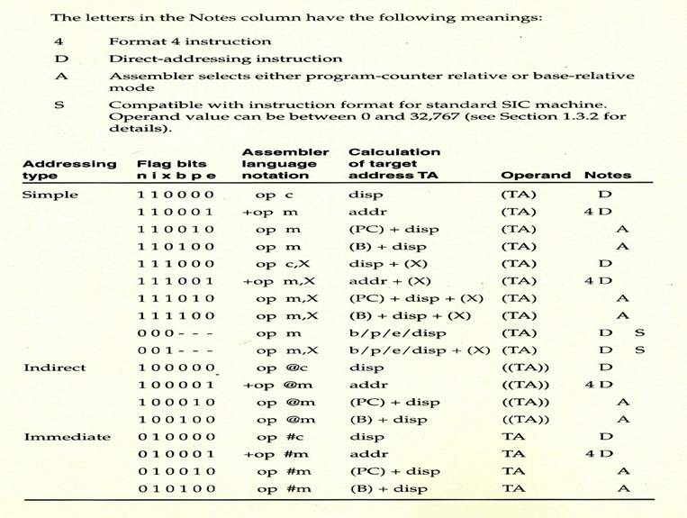
SIC/XE Machine Architecture (9/11)
Assembler decides
which format to use
Addressing Modes Summary (p.499)

Slide 38
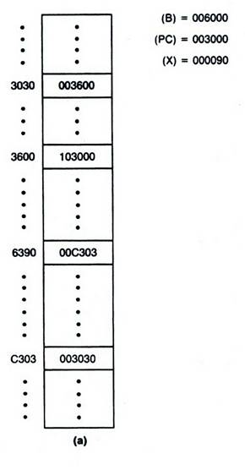
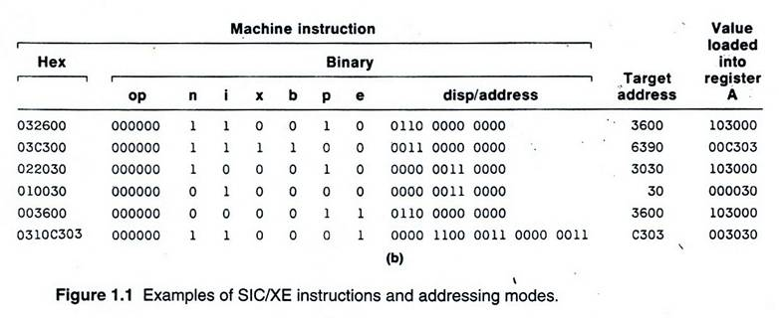
SIC/XE Machine Architecture (10/11)
Example Instruction
Format
(PC) + disp
(B) + disp + (X)
((PC) + disp)
disp
b/p/e + disp
addr

Slide 39
SIC/XE Machine Architecture (11/11)
Instruction set:
  load and store the new registers: LDB, STB, etc.
  Floating-point arithmetic operations
    ADDF, SUBF, MULF, DIVF
  Register move: RMO
  Register-to-register arithmetic operations
    ADDR, SUBR, MULR, DIVR
  Supervisor call: SVC
Input and output:
  I/O channels to perform I/O while CPU is executing other instructions: SIO, TIO, HIO

Slide 40
SIC/XE Programming Example (Fig 1.2b)
SIC version
SIC/XE version
LDA FIVE
STA ALPHA
LDCH CHARZ
STCH C1
.
.
.
ALPHA RESW 1
FIVE WORD 5
CHARZ BYTE C’Z’
C1 RESB 1
LDA #5
STA ALPHA
LDCH #90
STCH C1
.
.
.
ALPHA RESW 1
C1 RESB 1

Slide 41
SIC/XE Programming Example (Fig 1.3b)
LDS INCR
LDA ALPHA BETA=ALPHA+INCR-1
ADDR S,A
SUB #1
STA BETA
LDA GAMMA DELTA=GAMMA+INCR-1
ADDR S,A
SUB #1
STA DELTA
...
...
ALPHA RESW 1 one-word variables
BETA RESW 1
GAMMA RESW 1
DELTA RESW 1
INCR RESW 1

Slide 42
SIC/XE Programming Example (Fig 1.4b)
Looping and indexing: copy one string to another
LDT #11 initialize register T to 11
LDX #0 initialize index register to 0
MOVECH LDCH STR1,X load char from STR1 to reg A
STCH STR2,X store char into STR2
TIXR T add 1 to index, compare to 11
JLT MOVECH loop if “less than” 11
.
.
.
STR1 BYTE C’TEST STRING’
STR2 RESB 11

Slide 43
SIC/XE Programming Example (Fig 1.5b)
LDS #3
LDT #300
LDX #0
ADDLP LDA ALPHA,X load from ALPHA to reg A
ADD BETA,X
STA GAMMA,X store in a word in GAMMA
ADDR S,X add 3 to index value
COMPR X,T compare to 300
JLT ADDLP loop if less than 300
...
...
ALPHA RESW 100 array variables—100 words each
BETA RESW 100
GAMMA RESW 100

Slide 44
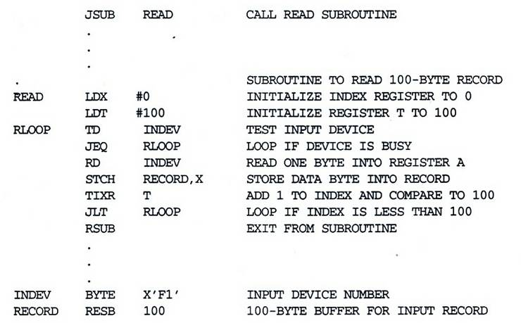
SIC/XE Programming Example (Fig 1.7b)

Slide 45
Emulating the SIC System
      An assembler and a simulator written by the author, Leland in Pascal is available on his educational home page at ftp://rohan.sdsu.edu/faculty/beck
      SIC/XE Simulator And Assembler downloadable at https://sites.google.com/site/sarimohsultan/Projects/sic-xe-simulator-and-assembler
      SIC Emulator, Assembler and some example programs written for SIC downloadable at http://sicvm.sourceforge.net/home.php
      SicTools - virtual machine, simulator, assembler and linker for the SIC/XE computer available at http://jurem.github.io/SicTools/

